Slide 1
Hepatitis C in Fraser Health Authority
BC Yukon Association of Drug War Survivors
Surrey Chapter
Hep C Workshop 1
April 18, 2015
Surrey Public Library
‘Revolutions begin when people perceived as ‘the problem’ gain the power to redefine the problem.’
John McKnight

Slide 3
BC Yukon Association of Drug War Survivors applied for a grant of $5000 to put on workshops on Hepatitis C in Fraser South region of Fraser Health Authority.
The grant is administrated through Positive Living Fraser Valley who provides support for people who test positive for HIV &/or Hep C in Fraser East which includes Abbotsford, Chillwack & Hope.
The workshops April 18 & 19 are being funded from this $5000 grant. We may schedule a third workshop.
The Health boundaries follow a nested hierarchy. Local Health Areas (LHAs) aggregate to Health Service Deliver Areas (HSDAs), which then aggregate to Health Authorities (HAs).

Slide 4
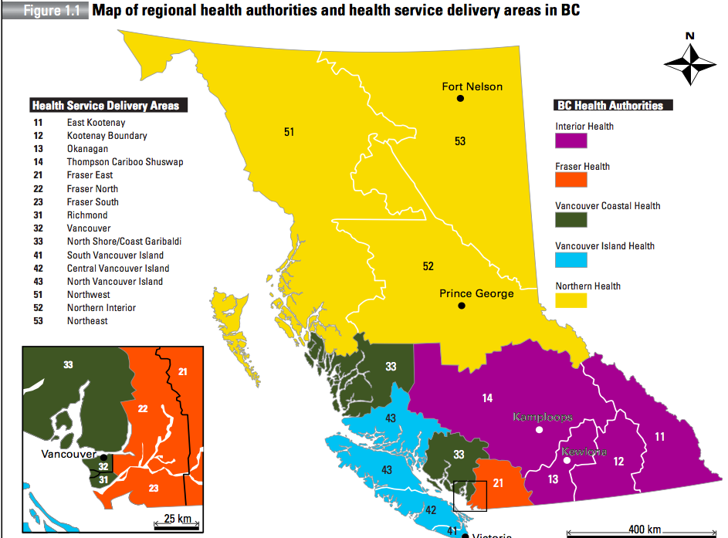
Fraser is 1 of
5 Regional Health Authorities

Slide 5
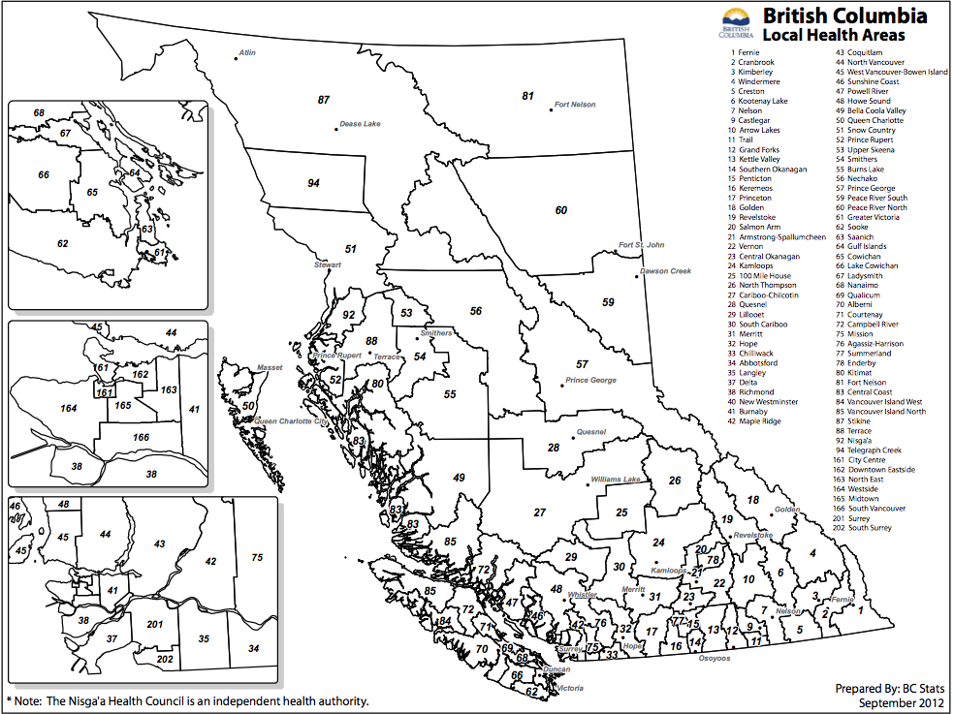
Fraser has 13 local Health Areas out of 89
Notes:
Fraser has 13 local Health Areas: 032 Hope 033 Chilliwack 034 Abbotsford 075 Mission 076 Agassiz-Harrison 040 New Westminster 041 Burnaby 042 Maple Ridge 043 Coquitlam 035 Langley 037 Delta 201 Surrey 202 Surrey/White Rock

Slide 6
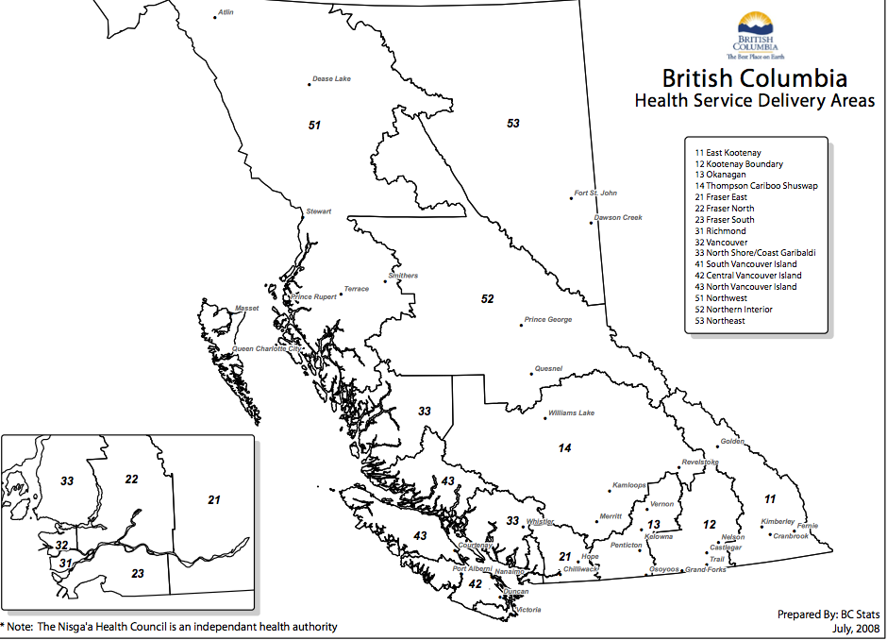
Fraser has 3 Health Delivery Areas out of 16 in BC
Notes:
Fraser has 3 Health Service Delivery Areas

Slide 7
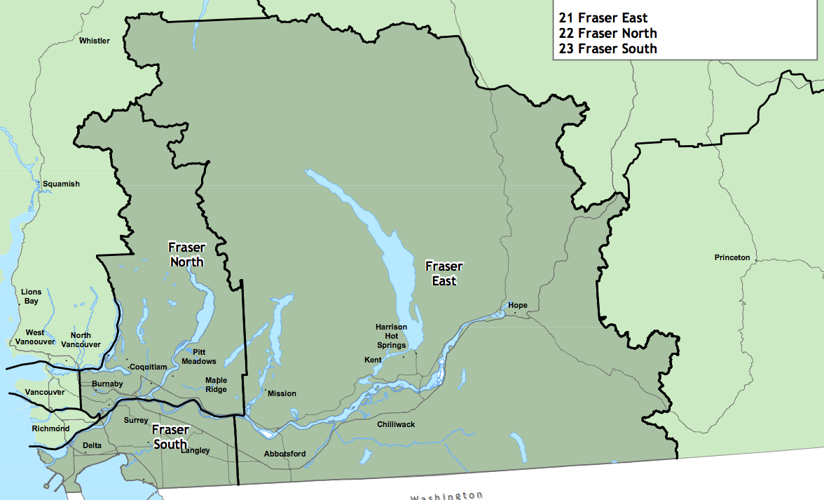
Fraser Health Authority has 3 Health Delivery Areas; North, East, South
Fraser South has 4 Local Health Areas; Surrey, Delta, White Rock & Langley

Slide 8
The population of BC continues to increase.
1986 - BC population 3.00 million
2013 – BC population 4.58 million
Fraser Health has;
the smallest geographic area
the largest population ~ 1.69 million in 2013
Vancouver Coastal Health pop. ~ 1.14 million,
Vancouver Island Health ~ 0.75 million,
Interior Health ~ 0.72 million
Northern Health has:
the largest geographic region
the smallest population with 0.28 million

Slide 9
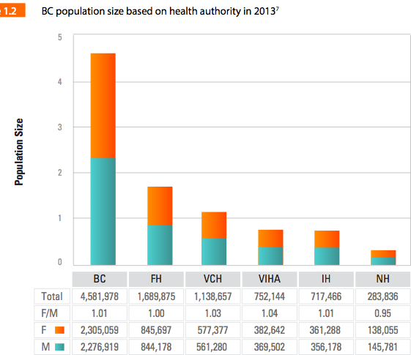
Notes:
The population of BC continues to increase; it was 3.00 million in 1986 and reached 4.58 million in 2013. When broken down by health authority (HA), the smallest geographic region FH has the largest population at about 1.69 million in 2013; VCH has 1.14 million, VIHA 0.75 million, IH 0.72 million and NH, the largest geographic region, has the smallest population with 0.28 million (Figure 1.2).

Slide 10
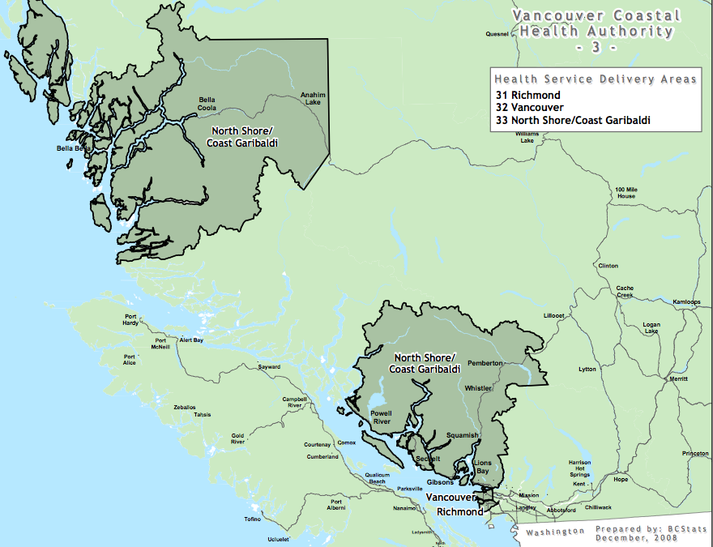
Vancouver Coastal has crazy boundaries

Slide 11
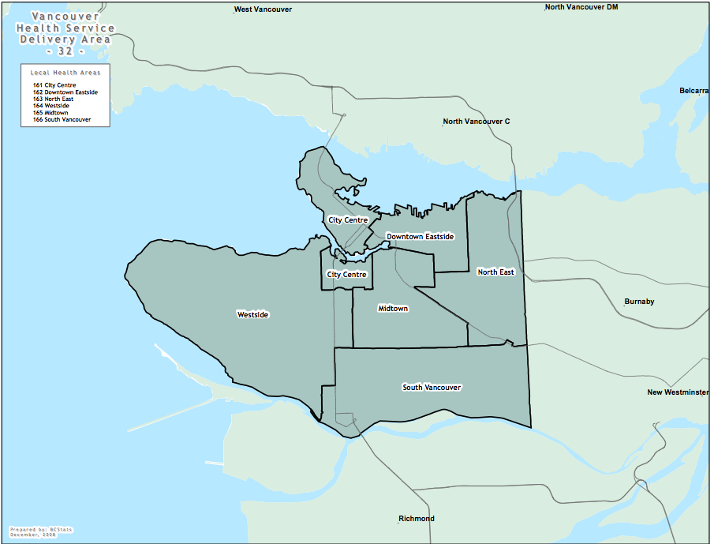
Downtown Eastside has high rates of Hep C.
Do people move between Surrey & the DTES?

Slide 12
Rates of Hep C in Fraser are high
Fraser East (Abbotsford)- 77/ 100,000 or 221 cases
Northern Interior (PG) – 65/ 100,000 or 92 cases
Vancouver (DTES)– 59/ 100,000 or 387 cases
^{North Vancouver Island}
(Courtney/Campbell River) - 58/ 100,000 or 69 cases
Fraser South (Surrey) - 40/100,000 or 307 cases
^{Fraser North (New West,}
Burnaby, tri-cities) - 36.5/ 100,000 or 232 cases

Slide 13
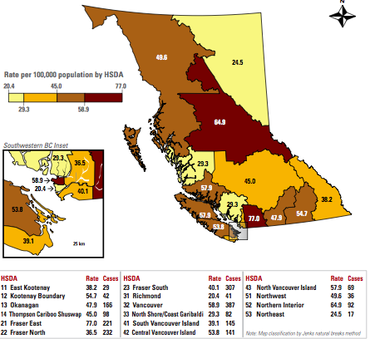

Slide 14
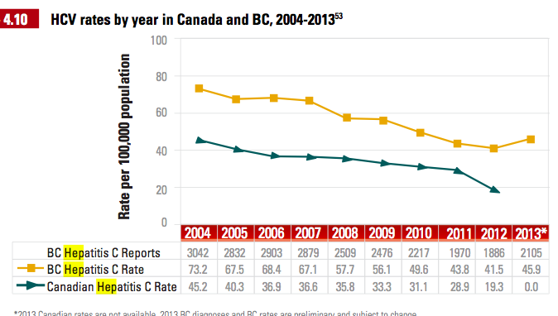
BC has significantly more Hep C than the rest of Canada

Slide 15
According to the Public Health Agency of Canada, about 54-70% of People Who Inject Drugs are infected with HCV in Canada.
^{Risk Factors}
Increased time exposed to Injection Drug Use and increased frequency of injection (e.g. cocaine with a short half-life may lead to frequent injections)
Requiring assistance for injecting
It is estimated that 48% of people who previously injected drugs are infected with HCV.

Slide 16
Number of Persons Using Injected Drugs
Canada : ~125,000
British Columbia: ~40,000
Vancouver: ~10,000-12,000
Downtown Eastside: ~5,000
Vancouver Coastal: ~14,000-16,000
Fraser Region: ~14,000-16,000
BC was thought to have more people using injection drugs than other provinces.
There are alarming outbreaks of HIV from injection drug use in both Saskatoon and Regina especially amongst Aboriginal people.
16
Notes:
Just want to ensure a bit of background
All numbers of people who use illegal drugs are estimates Hopefully they are intelligent I included this slide to assure you there is a significant amount of drug use in Fraser

Slide 17
What is the reasoning behind;
needle distribution,
the forming of Drug User Groups,
Methadone Maintenance Therapy,
safe consumption sites for both injecting & smoking drugs &
heroin and stimulant prescriptions?
These are Hep C prevention programs.

Slide 18
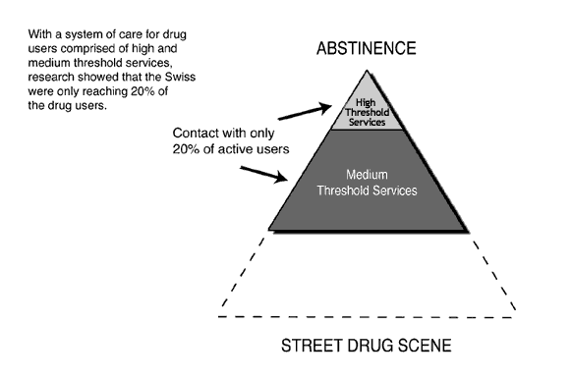
Harm Reduction was invented to Improve the Poor ‘Reach’ of Traditional Helping Systems to Prevent Hep C
18
Notes:
Addiction is a highly charged topic with little discussion of effective well researched interventions. Instead addiction cure testimonials seem to guide society's approach to severely addicted citizens. Because people addicted to illegal drugs are criminalized they are especially hated and feared and excluded even from the very addictions treatment facilities that serve them.
This slide illustrates the reason that people immersed in illegal drug addiction have little or NO CONTACT with health care funded services for addicts for an average of 5 years.

Slide 19
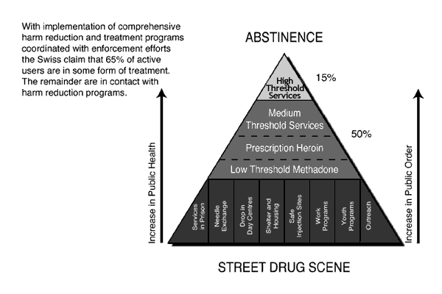
Reaching Drug Users Who Are Wild In The Streets with Hep C Prevention Interventions
19
Notes:
This old slide I included in case this board did not understand the clever public health strategy behind Harm Reduction Strategies. There are often accusations even from physicians who are “addictions specialists” that needle exchanges, safe sites, and drug user groups encourage drug use and increase drug use. All the carefully executed scientific research on harm reduction shows that disease rates decrease, public order increases and drug users who engage are way more likely to go to drug treatment.
Basically an addict who is going to a needle exchange, a drop in for users, a safe injection site, or participating in drug user group will consider getting on methadone or going to detox. Without any services for street involved people using drugs there is no hope and the people who use drugs internalize the hatred and their self care completely deteriorates. Please make a triangle like this for Fraser and implement it. Do not allow municipal bylaws to create no public health for vulnerable citizens.

Slide 20
^{HCV Facts:}
- The BC HCV diagnosis rate continues to be higher than the Canadian average; 41.5 and 19.3 cases per 100,000 population respectively in 2012.
- After a steady decline since 1997, the number of cases of HCV identified in BC rose in 2013 to 2,105 (from 1,886 in 2012).
- HCV testing has increased annually; in 2013 there were more than 200,000 HCV tests performed
-From 2008 through 2012, all regional health authorities experienced an overall decrease of 24 month HCV sero-conversion in people who had repeat tests.
- In 2013 rates were similar in all health authorities. (next)
- New effective treatments for HCV with fewer side-effects are being developed, are expensive and currently not yet widely available in BC.

Slide 21
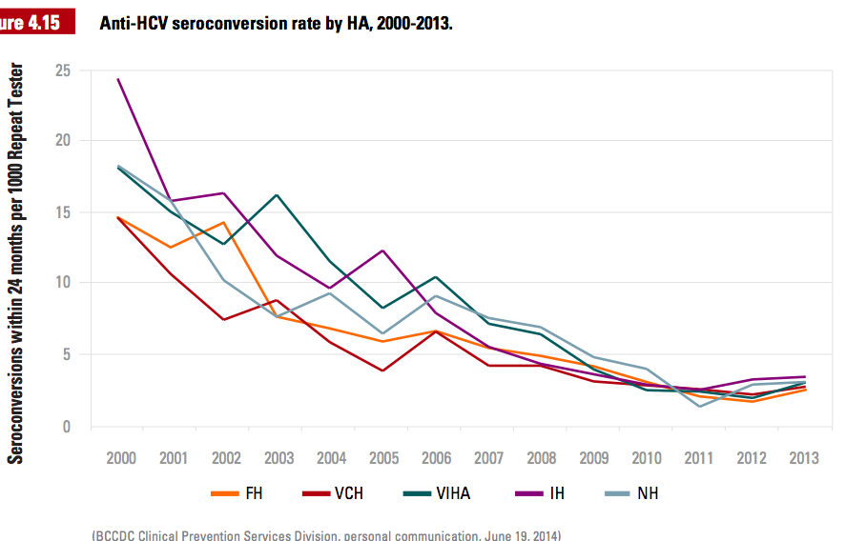
People Per 100,000 Who Test Negative & Then Test Positive Within 24 Months - Repeat Testers

Slide 22
What can fuel outbreaks of
Hepatitis C in Surrey?
An increased or continuing high number injections
Poor access to needles & harm reduction supplies
A lack of stable housing
An influx of Hep C positive injectors without access to needles or stable housing
No Hep C treatment for people who use drugs
Increased Policing & arrests as time in prison is a predictor of Hep C seroconversion

Slide 23
The reported use of heroin and crystal meth was highest in Fraser Health
(54% and 48% respectively).

Slide 24
, Crack cocaine use is highest in the Northern Health region (67%).
, Heroin use is highest in the Fraser Health region (54%).
, Marijuana use is highest in Interior Health (60%).
- Among BC youth in school, self-reported use of all psychoactive
substances declined from 2008 to 2013.
- Among a convenience sample of street-involved youth in Victoria and Vancouver
, Crystal methamphetamine and cocaine are the most widely used illicit drugs after marijuana.
, Reported crystal methamphetamine use in Victoria increased from 6% in 2011 to over 50% in 2013 .

Slide 25
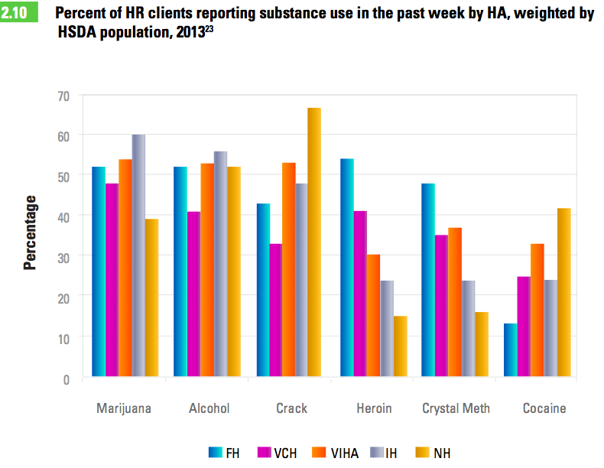
Notes:
Reported use of heroin and crystal meth was highest in FH (54% and 48% respectively).

Slide 26
In Fraser, harm reduction clients who inject drugs reported difficulty acquiring needles, citing supply distribution center operating hours and distance as the main barriers.
Population rate of needle/syringe distribution varies by health authority. Vancouver Coastal Health had the highest rate (450/100,000) and Fraser Health the lowest (49/100,000).

Slide 27
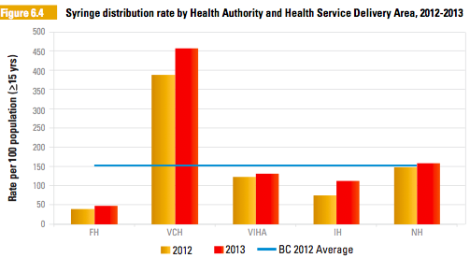
Fraser Health has
doubled the number
of needles distributed & still is
failing to distribute adequate
harm reduction supplies

Slide 28
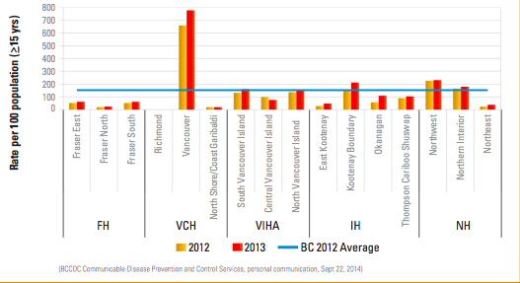
Harm reduction supply distribution in BC is inequitable between & within health authorities and should be addressed.

Slide 29
What is hepatitis C?
https://www.youtube.com/watch?v=6iv6up3TNbQ&feature=share

Slide 30
Are you at risk for hepatitis C?
Consider screening for hepatitis C if you’ve…
shared equipment for injected drugs, including steroids
snorted cocaine or shared crack pipes
had a blood transfusion prior to 1992
acquired tattoos or piercings in unregulated or uninspected premises, or with unsterile needles and re-usable ink (ie prison)

Slide 31
Effective Hep C Prevention
Needle exchange in prison
Safe Tattoo Programs in prison
Safe injection & smoking Sites
No arrests for drugs (stay out of jail!)
Treatment for Hep C positive people

Slide 33
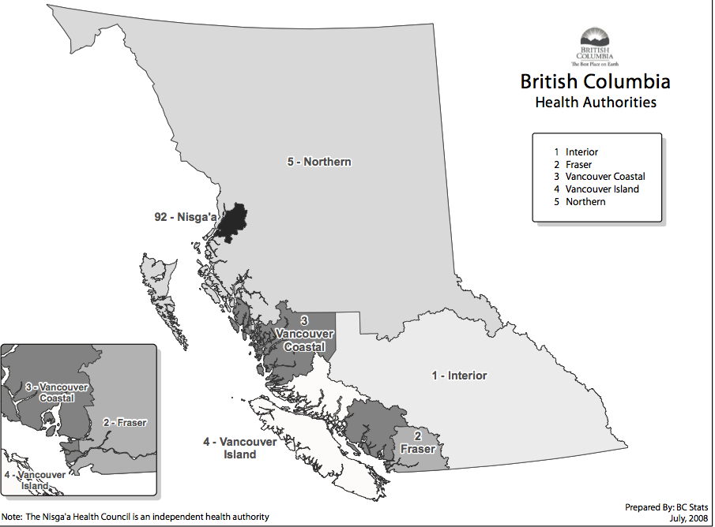
Fraser is 1 of 5 Regional Health Authorities
Notes:
BC is divided into 5 Health Authorities

Slide 34
